Slide 1
01
FINAL PROJECT · COMPUTER VISION & DEEP LEARNING
Weather- and Lighting-Robust
Traffic Sign Classification
Multi-task learning with a synthetic adverse-condition dataset
3
8
11
MODELS COMPARED
TEST CONDITIONS
REAL-WORLD SIGNS

Slide 2
THE PROBLEM
Why robustness matters
Modern traffic-sign classifiers achieve 94–99% accuracy on clean benchmarks like GTSRB.
But deployment conditions are not clean.
Fog, rain, glare, low light, motion blur, and shadows all degrade
classifier performance — sometimes catastrophically.
Our baseline on rain:
8.7%
accuracy
vs. 92.7% on clean images.
An 84-point gap from a single weather condition.
In autonomous driving, this gap is a safety problem.
Weather- and Lighting-Robust Traffic Sign Classification
2 / 22

Slide 3
THE PROJECT
What we built
A multi-task ResNet-18 trained on GTSRB plus a synthetic adverse-condition dataset, evaluated for robustness across 8 visual conditions and on hand-collected real-world adverse images.
01
02
03
Unique dataset
Multi-task architecture
Fair evaluation
Seven synthetic corruption types built on top of GTSRB. Each image gets both a sign label and a condition label.
Dual-head ResNet-18: 43-class sign output plus 8-class condition output, trained jointly with weighted cross-entropy.
Per-condition test accuracy + ablation on corruption probability + a hand-cropped real-world adverse-condition test set.
Satisfies the rubric on both axes: a unique dataset AND a novel architectural adaptation.
Weather- and Lighting-Robust Traffic Sign Classification
3 / 22

Slide 4
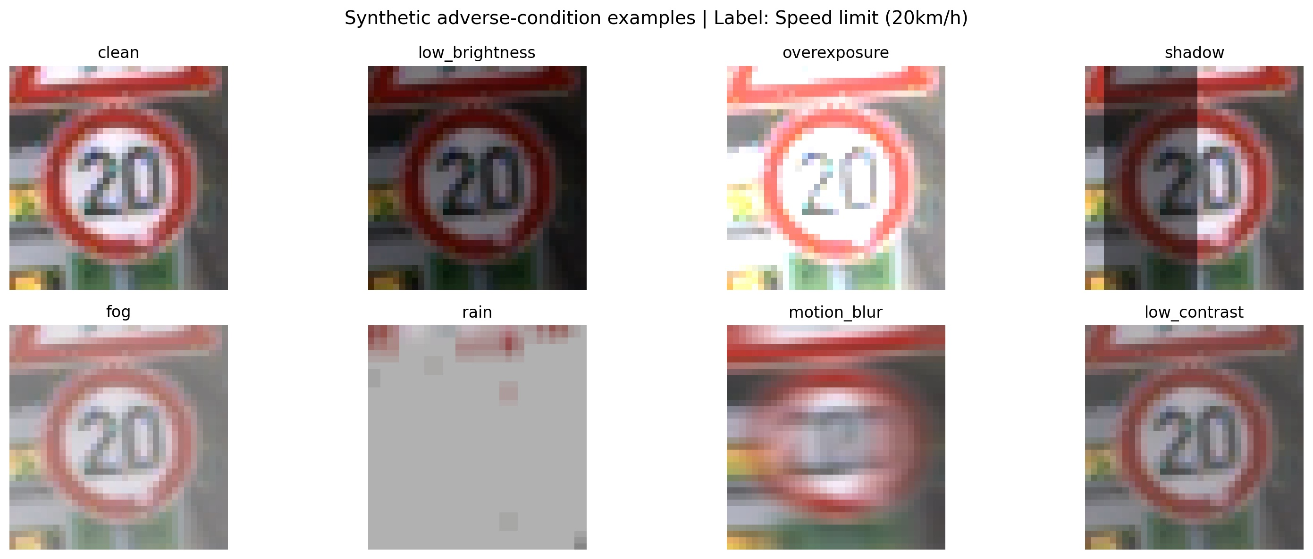
DATASET
From clean GTSRB to a corruption-aware dataset
7 corruption types
Low brightness (dusk / underexposure)
Overexposure (direct sunlight)
Shadow (diagonal occlusion)
Fog (white haze + low contrast)
Rain (vertical streaks + blur)
Motion blur (horizontal kernel)
Low contrast (compressed range)
Applied at p = 0.7 during training; each corrupted sample also gets a condition label (1–7); clean samples get label 0.
One sign · 8 conditions (clean + 7 synthetic corruptions)
Weather- and Lighting-Robust Traffic Sign Classification
4 / 22

Slide 5
ARCHITECTURE
Multi-task ResNet-18
primary task
sign_head
Linear 512 → 43
Input image
(3 × 64 × 64)
ResNet-18 backbone
(ImageNet pretrained)
Pooled features
(512-d)
condition_head
Linear 512 → 8
auxiliary task (regularizer)
Joint training loss
Ltotal = Lsign + λ · Lcondition (λ = 0.3)
Weather- and Lighting-Robust Traffic Sign Classification
5 / 22

Slide 6
METHOD
Training setup & three-way comparison
HYPERPARAMETERS
THREE TRAINED MODELS
Backbone | ResNet-18, ImageNet pretrained
Image size | 64 × 64
Optimizer | Adam, lr = 1e-4
Batch size | 128
Epochs | 6 (val. plateaus by 5)
Train subset | 20,000 images (seed = 42)
Test subset | 5,000 images (held out)
Corruption prob. | p = 0.7
Aux. loss weight | λ = 0.3
Model | Training data | Heads
Baseline | Clean only | Sign (43)
Augmented | Clean + 7 corruptions | Sign (43)
Multi-Task | Clean + 7 corruptions | Sign (43) + Condition (8)
WHY THREE MODELS?
Baseline → Augmented isolates the data contribution.
Augmented → Multi-Task isolates the architecture contribution.
Weather- and Lighting-Robust Traffic Sign Classification
6 / 22

Slide 7
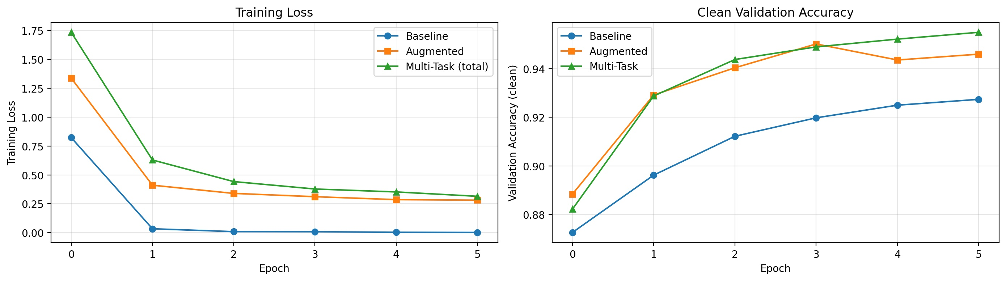
TRAINING
Training behavior across all three models
Baseline overfits fast
Loss collapses by epoch 1 — clean GTSRB is too easy.
Augmented + Multi-Task track each other
Both converge cleanly with corrupted inputs adding healthy regularization.
Multi-Task wins clean accuracy
95.5% clean — auxiliary task adds zero cost on the primary task.
All three models converge by epoch 5; we save the best by clean validation accuracy.
Weather- and Lighting-Robust Traffic Sign Classification
7 / 22

Slide 8
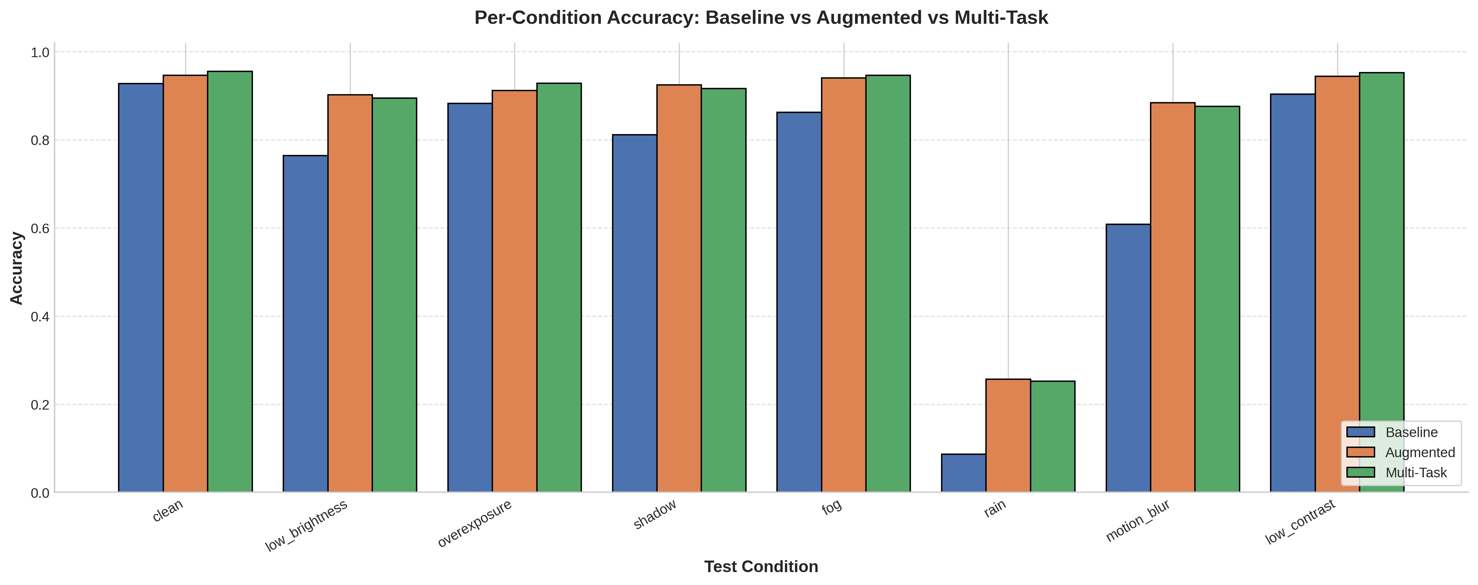
RESULTS
Per-condition accuracy across all three models
HEADLINE
84.0%
Multi-Task mean accuracy across all 8 conditions
vs. 73.1% baseline
+10.9 points improvement
Multi-Task and Augmented track each other; both substantially beat Baseline.
Weather- and Lighting-Robust Traffic Sign Classification
8 / 22

Slide 9
RESULTS
The numbers, condition by condition
Condition | Baseline | Augmented | Multi-Task | Cond. acc.
clean | 92.7% | 94.6% | 95.5% | 89.5%
low_brightness | 76.4% | 90.2% | 89.5% | 93.0%
overexposure | 88.3% | 91.2% | 92.8% | 84.6%
shadow | 81.2% | 92.5% | 91.7% | 93.4%
fog | 86.3% | 94.0% | 94.6% | 96.0%
rain | 8.7% | 25.7% | 25.3% | 99.8%
motion_blur | 60.8% | 88.4% | 87.6% | 95.5%
low_contrast | 90.3% | 94.4% | 95.2% | 90.0%
Mean | 73.1% | 83.9% | 84.0% | 92.7%
KEY OBSERVATIONS
Clean: Multi-Task wins (95.5%).
Worst case: rain — 8.7% → 25.3%, +16.6 points.
Biggest gain: motion blur — 60.8% → 87.6%.
Aux. head: 92.7% mean accuracy on condition prediction.
Highlighted column: Multi-Task winning per-condition. Cond. acc. = how well the auxiliary head predicts which corruption is present.
Weather- and Lighting-Robust Traffic Sign Classification
9 / 22

Slide 10
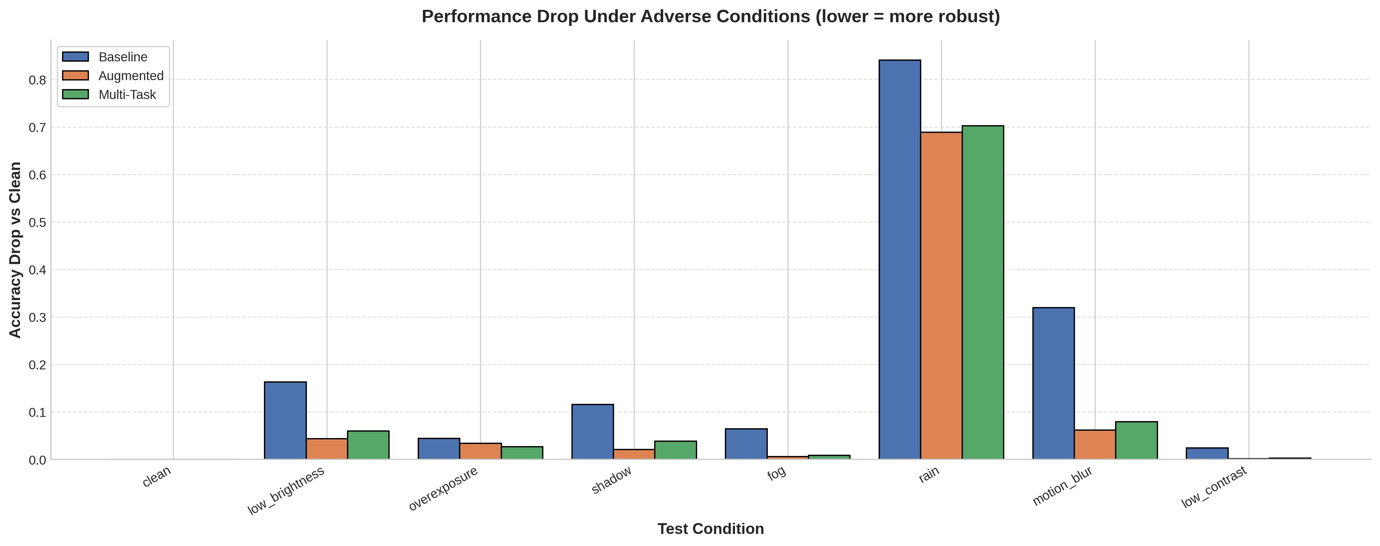
RESULTS
Performance drop under adverse conditions
HOW TO READ
Lower bars = more robust.
Each bar shows how much accuracy
drops vs. clean
for that model under that condition.
Augmented & Multi-Task drops are nearly indistinguishable — both are dramatically smaller than Baseline's.
Weather- and Lighting-Robust Traffic Sign Classification
10 / 22

Slide 11
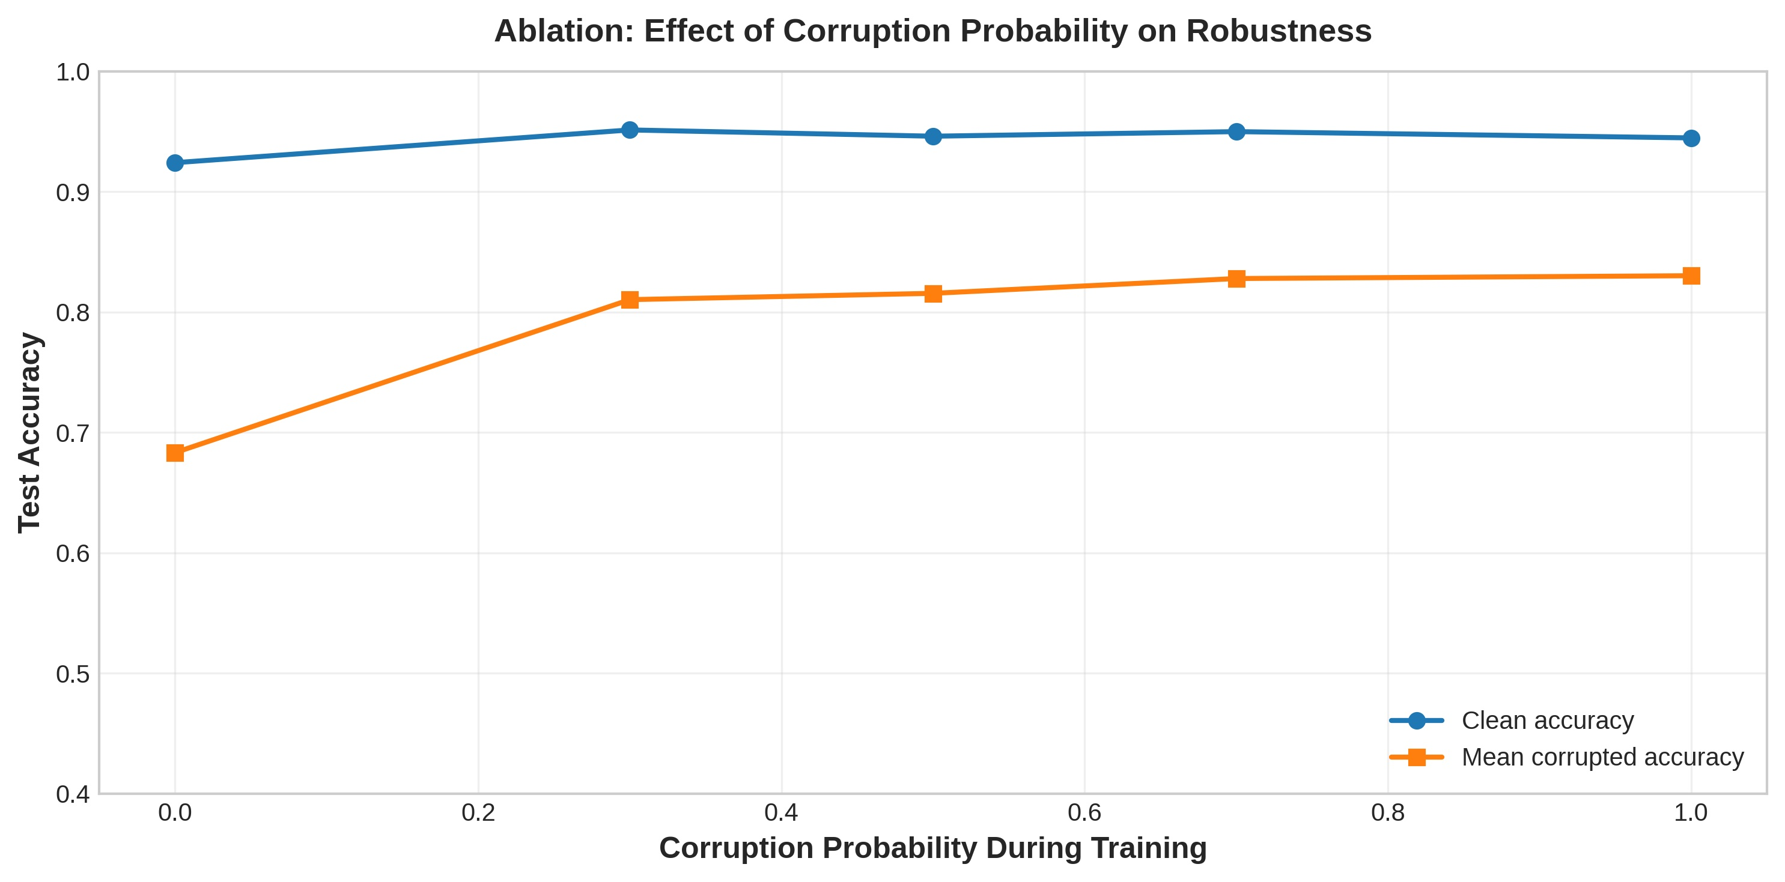
ABLATION
Ablation: how much corruption is enough?
THE QUESTION
Does training with more corruption help — and how much?
THE EXPERIMENT
Re-train Augmented at p ∈ {0.0, 0.3, 0.5, 0.7, 1.0}.
THE FINDING
Sharp gain from p=0.0 → p=0.3 (68.3% → 81.0% mean corrupted).
Diminishing returns past p=0.5.
p=0.7 (chosen) sits at the elbow of the curve — strong robustness, no sacrifice on clean.
Weather- and Lighting-Robust Traffic Sign Classification
11 / 22

Slide 12
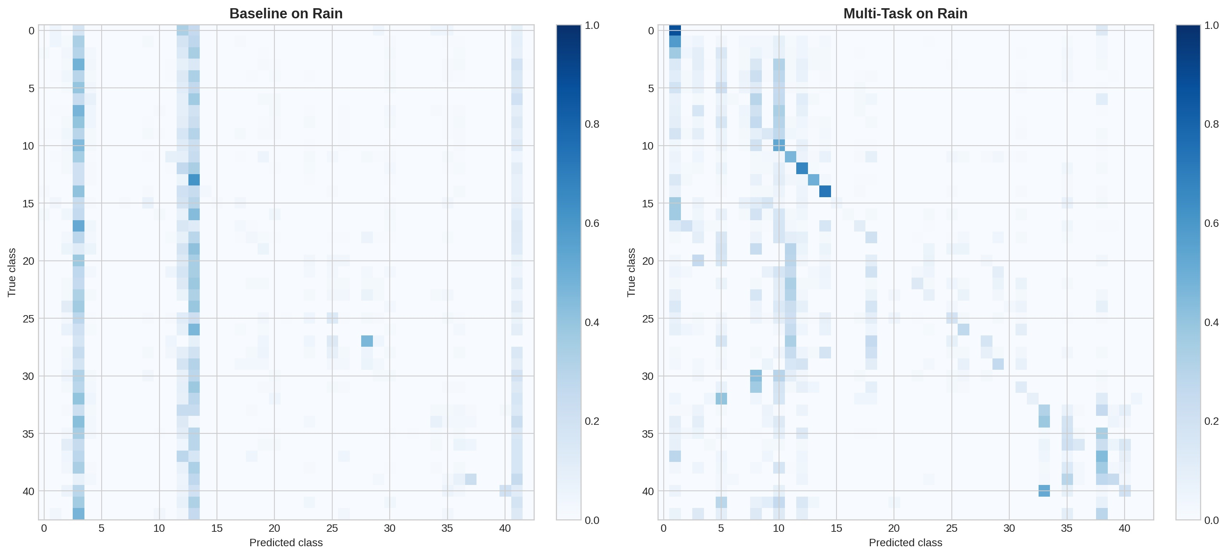
DIAGNOSTIC
Where the baseline collapses: confusion on rain
BEFORE
Baseline collapses to a few attractor classes — vertical bands at predicted classes 3 and 13. The model has no idea what it's looking at and guesses the same few options.
AFTER
Multi-Task shows a visible diagonal — predictions correlate with true classes. Far from perfect on rain (25%), but a structural shift, not noise.
Weather- and Lighting-Robust Traffic Sign Classification
12 / 22

Slide 13
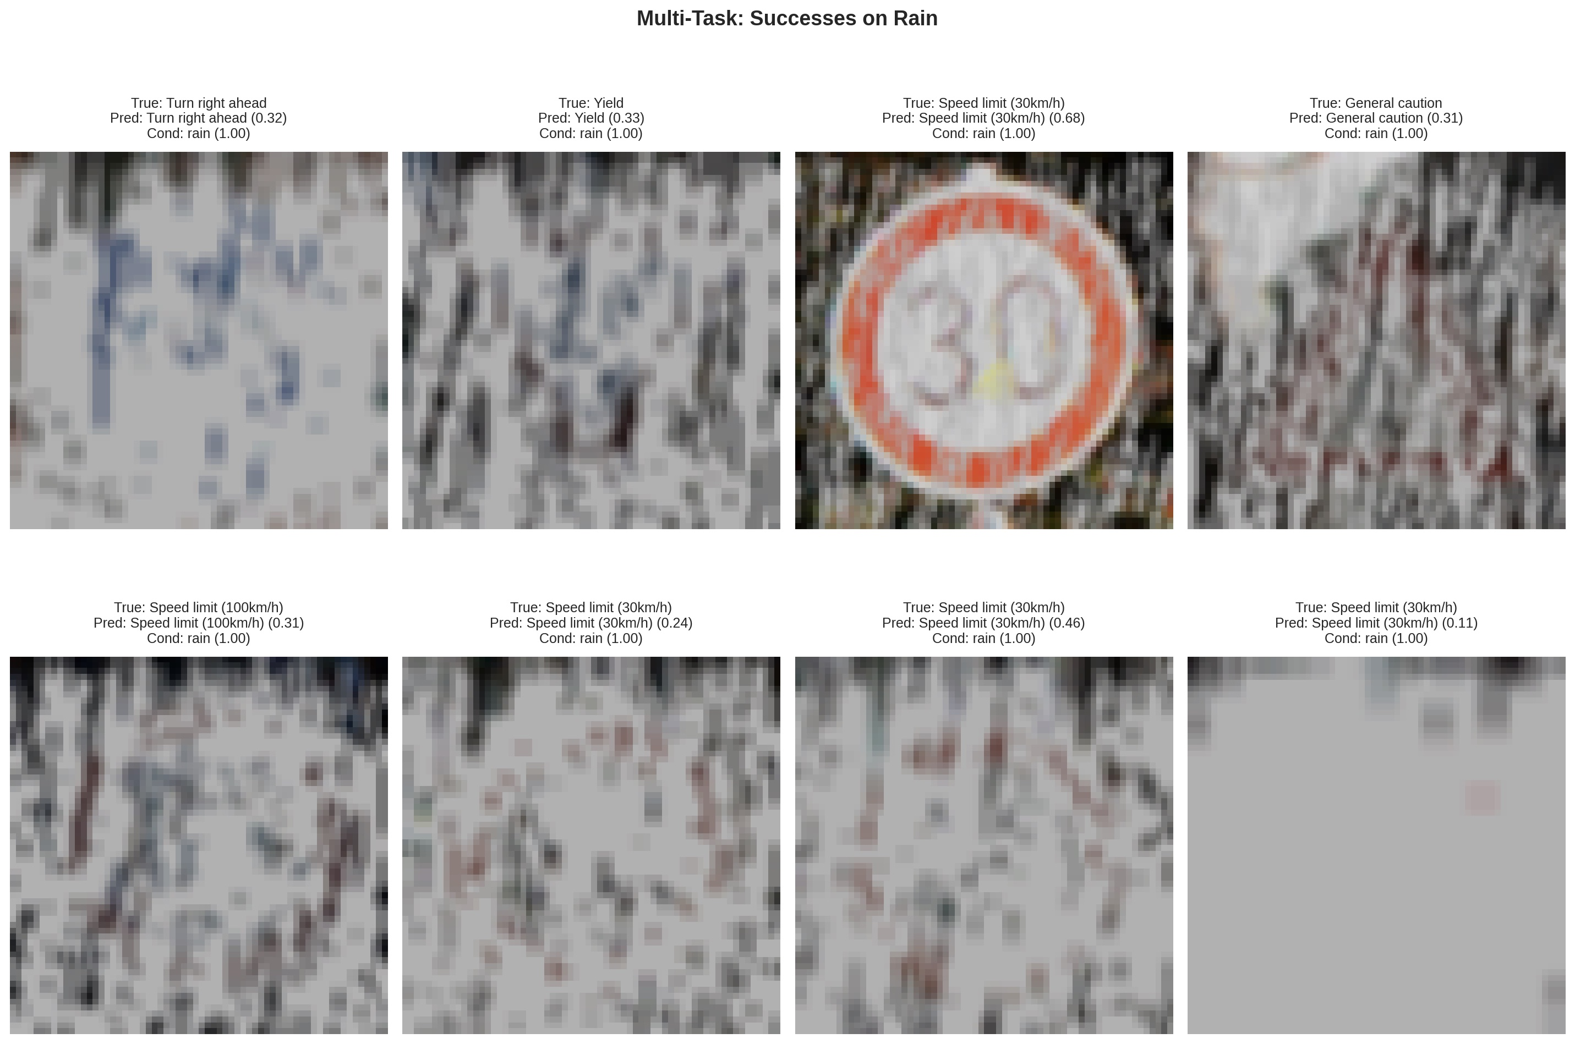
QUALITATIVE
Qualitative: the model gets it right on rain
Even when most of the sign is occluded by rain streaks, the model recovers correct sign + condition predictions when partial signal remains.
Weather- and Lighting-Robust Traffic Sign Classification
13 / 22

Slide 14
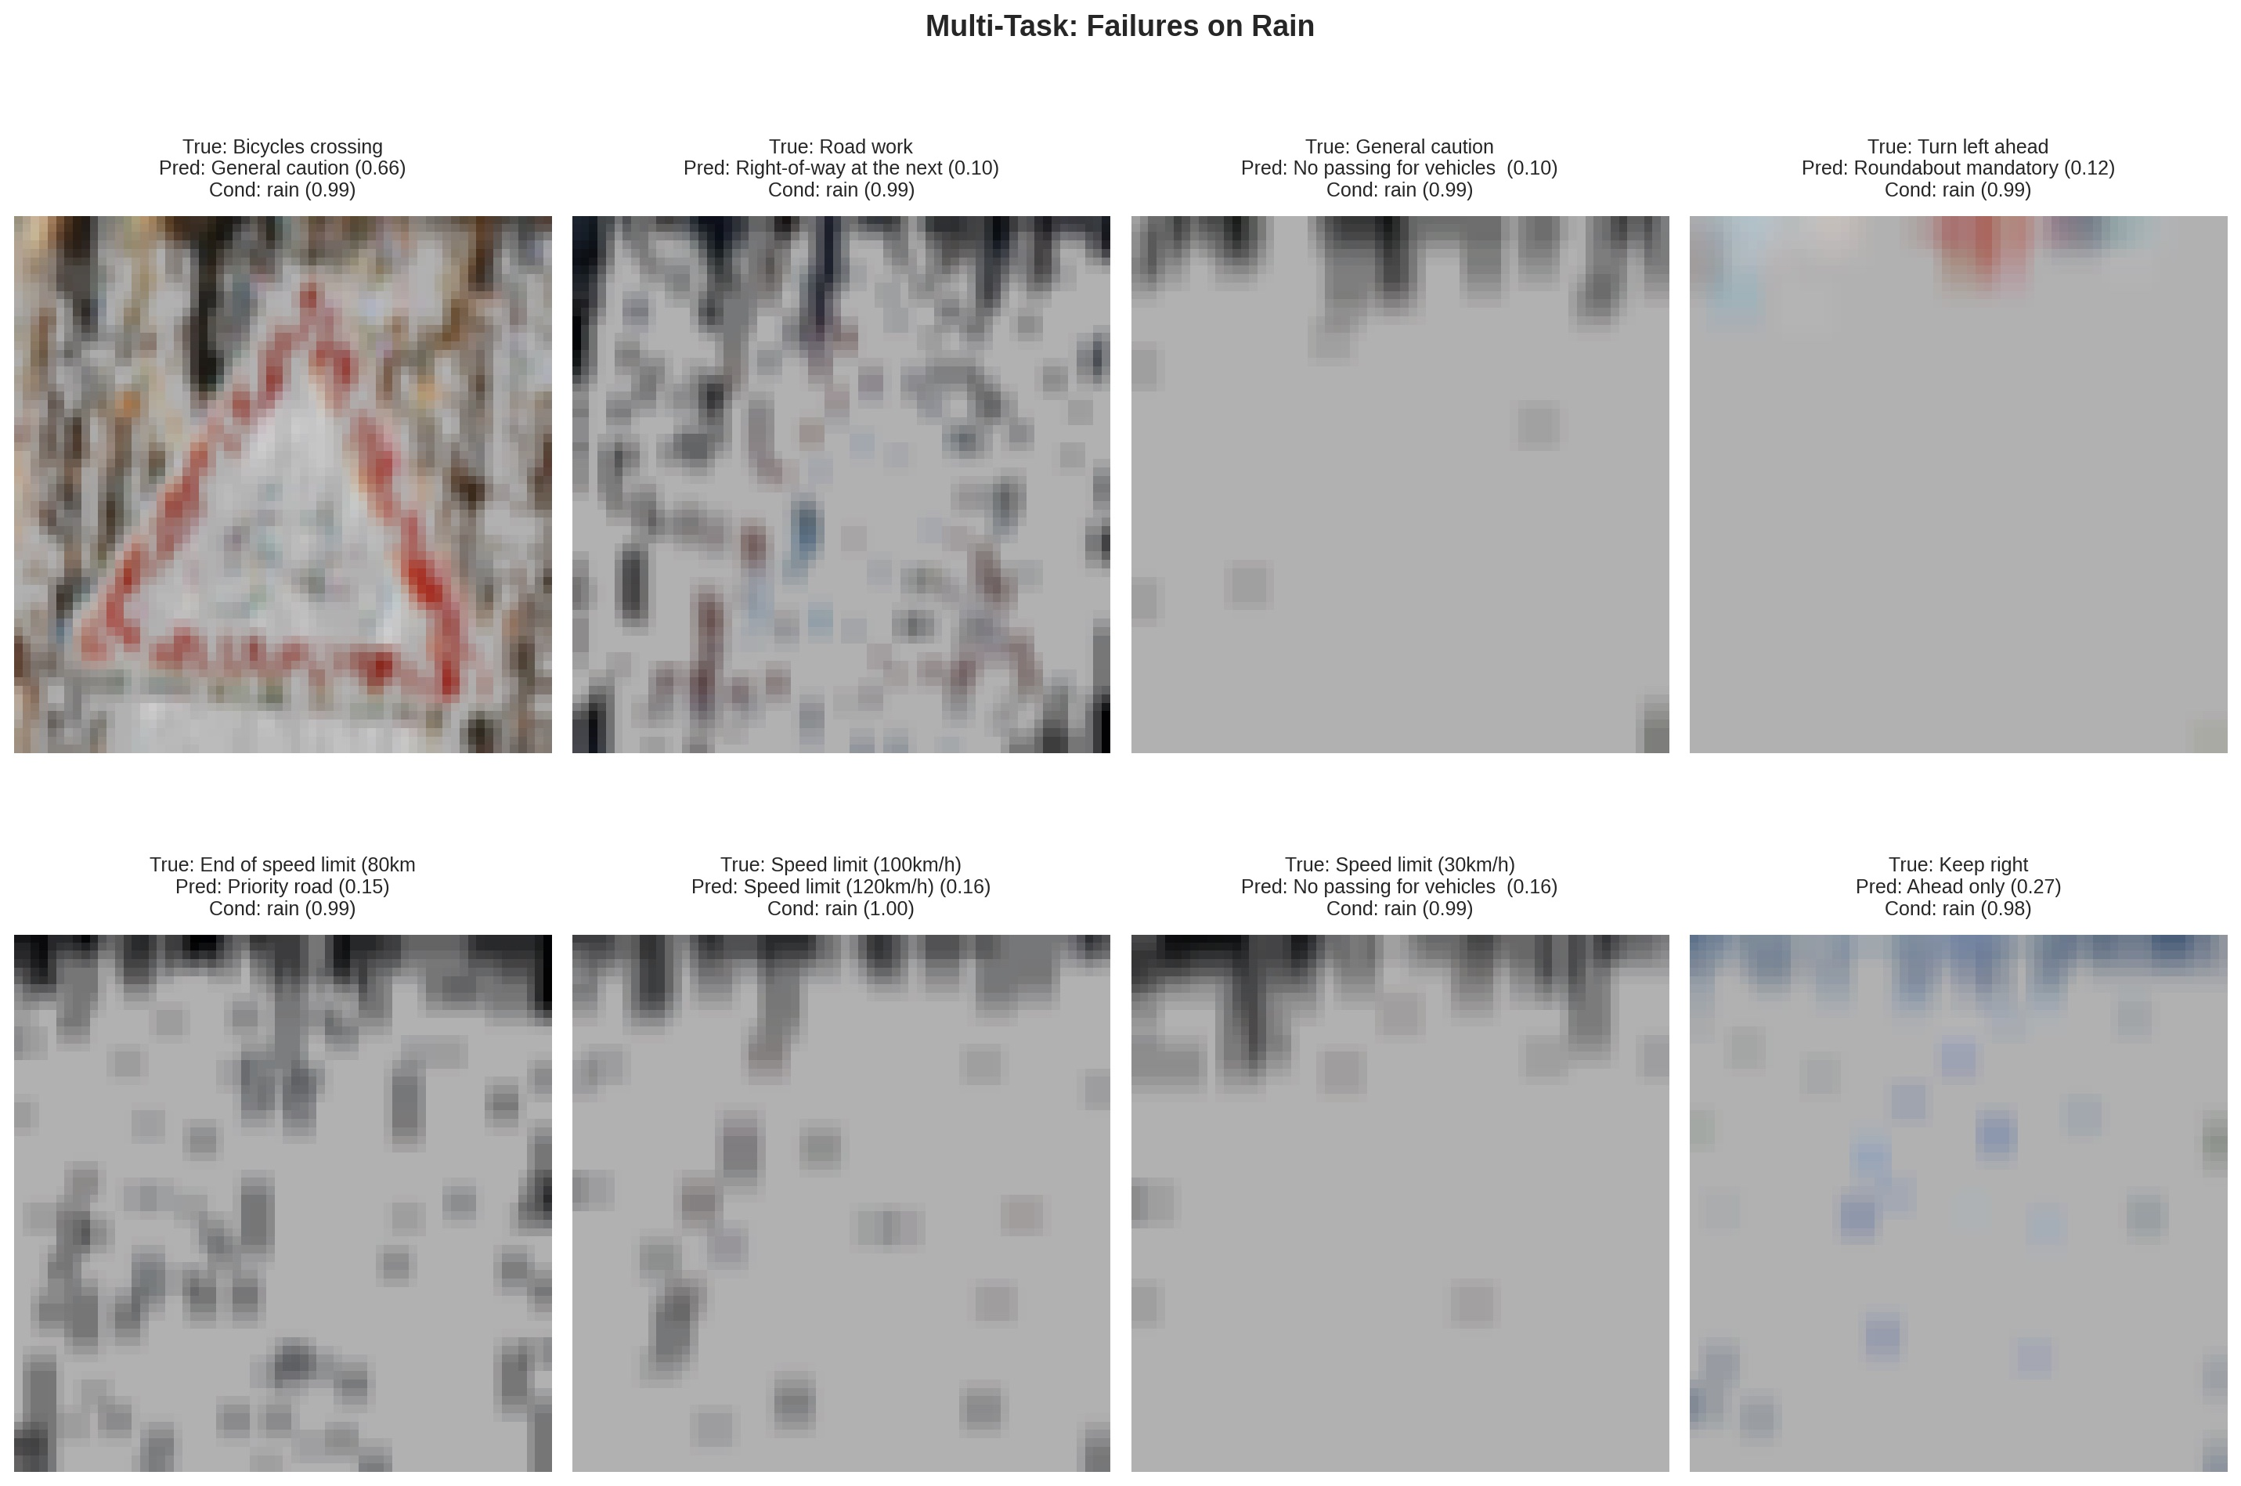
QUALITATIVE
Qualitative: where it breaks
Notice: the condition head still confidently predicts rain (~99%) — the failure is in sign identity, not condition awareness. When occlusion is total, no model can recover the answer; the multi-task head at least knows why it's failing.
Weather- and Lighting-Robust Traffic Sign Classification
14 / 22

Slide 15
REAL-WORLD
Beyond synthetic: testing on real adverse images
Synthetic corruptions are stylized. The harder, fairer test is: does the model generalize to real adverse-weather photographs it has never seen?
PASS 1
PASS 2
Uncropped scenes — qualitative
Cropped + labeled — quantitative
24 hand-collected wide-angle adverse-condition photos.
Reports the model's predicted sign + predicted condition + confidence on each.
Not directly comparable to GTSRB-cropped training inputs — used as a stability check, not an accuracy benchmark.
Hand-cropped traffic signs, manually labeled with GTSRB classes.
N = 11 across rain, fog, glare, and night.
This is real-world
accuracy — directly addressing the project pitch comment.
Weather- and Lighting-Robust Traffic Sign Classification
15 / 22

Slide 16
REAL-WORLD RESULT
Real-world accuracy: 72.7%
CROPPED REAL-WORLD ACCURACY
BY CONDITION FOLDER
72.7%
Folder | Correct | Total | Accuracy
rain | 3 | 3 | 100%
night | 2 | 2 | 100%
fog | 2 | 4 | 50%
glare | 1 | 2 | 50%
Total | 8 | 11 | 72.7%
8 correct out of 11
And on rain specifically: 3/3 = 100%.
Higher than the model's own synthetic-rain stress test (25.3%) — features generalize.
Limitation: N = 11 is small. The cropped set is bounded by how many GTSRB-class signs appeared in our hand-collected photos. We treat this as a directional indicator, not a benchmark.
Weather- and Lighting-Robust Traffic Sign Classification
16 / 22

Slide 17
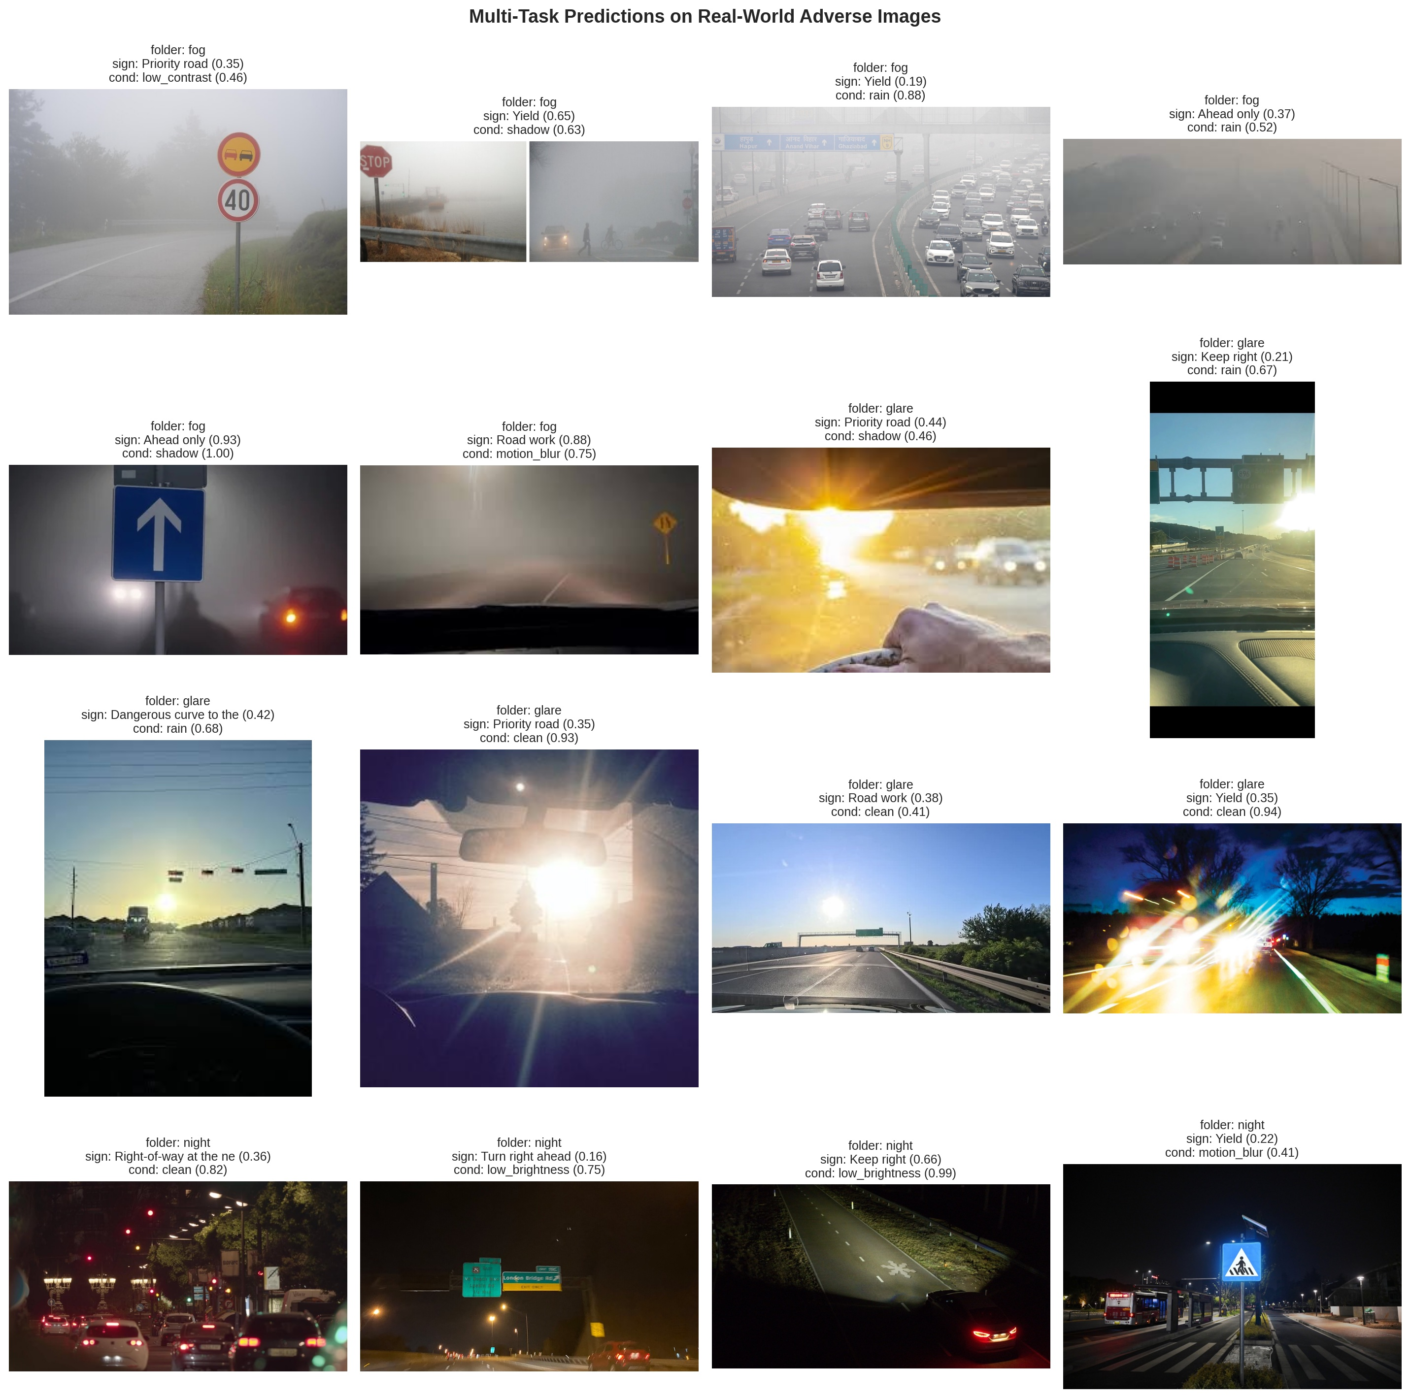
REAL-WORLD
Predictions on real-world adverse images
Each image shows folder · predicted sign · predicted condition. Wide-scene images (out-of-distribution for the cropped-input model) tested for prediction stability.
Weather- and Lighting-Robust Traffic Sign Classification
17 / 22

Slide 18
THE DEMO
Live inference on real adverse images
01
Loads the multi-task model
02
Runs on real adverse images
Pretrained ResNet-18 dual-head checkpoint loaded into Colab.
Wide-scene photos plus cropped GTSRB-class signs across rain, fog, glare, night.
03
Shows two predictions per image
04
Reports real-world accuracy
Sign class + adverse condition type, both with confidence scores.
Computes 72.7% top-1 on the cropped + labeled subset — addressing the pitch comment directly.
18 / 22

Slide 19
CODE
Implementation: the multi-task model
WHAT THIS DOES
class MultiTaskResNet18(nn.Module):
def __init__(self, num_classes=43, num_conditions=8):
super().__init__()
backbone = models.resnet18(weights=ResNet18_Weights.IMAGENET1K_V1)
feat_dim = backbone.fc.in_features # 512
backbone.fc = nn.Identity() # strip head
self.backbone = backbone
self.sign_head = nn.Linear(feat_dim, num_classes)
self.condition_head = nn.Linear(feat_dim, num_conditions)
def forward(self, x):
feats = self.backbone(x)
return self.sign_head(feats), self.condition_head(feats)
Shared backbone, two heads.
Replace ResNet's classification layer with
Identity() to expose pooled features.
Attach two parallel
Linear heads — one for the sign class, one for the condition class.
Forward returns both logits as a tuple — the training loop applies cross-entropy to each.
Weather- and Lighting-Robust Traffic Sign Classification
19 / 22

Slide 20
CODE
Implementation: joint training step
WHY THIS WORKS
# Forward through dual-head model
sign_logits, cond_logits = model(images)
# Two cross-entropies, weighted sum
loss_sign = criterion_sign(sign_logits, sign_labels)
loss_cond = criterion_cond(cond_logits, cond_labels)
loss = loss_sign + AUX_LOSS_WEIGHT * loss_cond # λ = 0.3
# Backprop through both heads via shared backbone
loss.backward()
optimizer.step()
Both losses share gradients through the same backbone.
The condition task forces the backbone to encode degradation type explicitly.
λ = 0.3
keeps the auxiliary task as a regularizer — strong enough to shape features, weak enough not to dominate.
Result:
the model learns sign identity and corruption identity jointly, with no extra cost on primary-task accuracy.
Weather- and Lighting-Robust Traffic Sign Classification
20 / 22

Slide 21
HONEST
Limitations & future work
LIMITATIONS
FUTURE WORK
Synthetic rain is aggressive
Real-data fine-tuning
Our rain pipeline whites out signs heavily. Even Multi-Task lands at 25% on synthetic rain — likely a stress test harder than realistic rain.
Fine-tune on CURE-TSR or Mapillary's adverse-conditions traffic-sign data. Direct comparison with our synthetic-trained model.
Multi-Task ≈ Augmented on robustness
Physically-based corruption
The architecture matches the augmented model's accuracy without exceeding it on most conditions. The auxiliary task is a regularizer + free condition prediction — not a dominant gain on its own.
Replace stylized rain/fog/blur with rendering-based corruption (e.g. ray-traced rain streaks, atmospheric scattering for fog).
Real-world test set is small
Adaptive auxiliary weighting
N = 11. Bounded by the supply of GTSRB-class signs in our hand-collected adverse photos. Treated as a directional indicator.
Replace fixed λ = 0.3 with uncertainty-weighted multi-task loss (Kendall et al. 2018) — allow λ to be learned.
Weather- and Lighting-Robust Traffic Sign Classification
21 / 22

Slide 22
CONCLUSION
Three takeaways
01
Adverse-condition data matters more than architecture
+10.9 points mean accuracy from training on synthetic corruptions. Adding the multi-task head matched but did not exceed the augmented gain.
02
The multi-task head is a free win
Same primary-task accuracy as Augmented, plus a 92.7%-accurate condition predictor and disentangled features — at no robustness cost.
03
Synthetic features generalize
72.7% real-world accuracy, with 100% on rain — substantially better than our own synthetic stress test predicted. The pipeline works.
Thank you · questions?

